Slide 1
Review Session 6
API-201, 10.22.21
Sophie Hill

Slide 2
What are you finding tricky with this week’s material?

Slide 3
Plan for today
Review new material (t-distribution, testing difference in means/proportions)
Practice Problem
Tips for PSet 6
Heads up: Sophie is on strike with her union next week Weds-Fri!

Slide 4

Why I am going on strike
I love teaching you all!
I also think that my labor is valuable and that Harvard could not function without its student workers
The graduate student union, HGSU, made a comprehensive series of proposals to the University on August 31st. It has been 7 weeks now and the University has not bothered to respond.
We have two main asks:
A living wage
Real recourse against sexual harassment

Slide 5
Why I am going on strike
I love teaching you all!
I also think that my labor is valuable and that Harvard could not function without its student workers
The Harvard Graduate Student Union, HGSU, made a series of proposals to the University on August 31st. It has been 7 weeks now and the University has not bothered to respond.
We have two main asks:
A living wage
Real recourse against sexual harassment

Slide 6
Why I am going on strike
I love teaching you all!
I also think that my labor is valuable and that Harvard could not function without its student workers
The Harvard Graduate Student Union, HGSU, made a series of proposals to the University on August 31st. It has been 7 weeks now and the University has not bothered to respond.
We have two main asks:
A living wage
Real recourse against sexual harassment

Slide 7

What does this mean for you?
The strike has been called for Weds 27th - Fri 29th October.
During that period, I will not be responding to any class-related emails or Slack messages.
I will not be holding Office Hours on Thurs 28th, nor a Review Session on Fri 29th.
I will return to work when the strike is over on Monday Nov 1st.
The first HGSU strike in Dec 2019. (Bloody freezing!!)

Slide 8
What does this mean for you?
Most importantly: I care deeply about your learning progress, and I want all of you to have the resources you need to succeed.
But your TFs and CAs cannot do their best work when they are worried about whether they can make rent this month.
I hope you will understand why this is important to me, and know that I will be ready to continue supporting you when the strike is over!
The first HGSU strike in Dec 2019. (Bloody freezing!!)

Slide 9
t-distribution

Slide 10
Which distribution to use?
Note: 𝝈 = population standard deviation
For proportions / difference-in-proportions:
→ normal distribution
For means / difference-in-means:
If 𝝈 is known → normal distribution
If 𝝈 is unknown → t-distribution

Slide 11
Which distribution to use?
Note: 𝝈 = population standard deviation
For proportions / difference-in-proportions:
→ normal distribution
For means / difference-in-means:
If 𝝈 is known → normal distribution
If 𝝈 is unknown → t-distribution
Why?

Slide 12
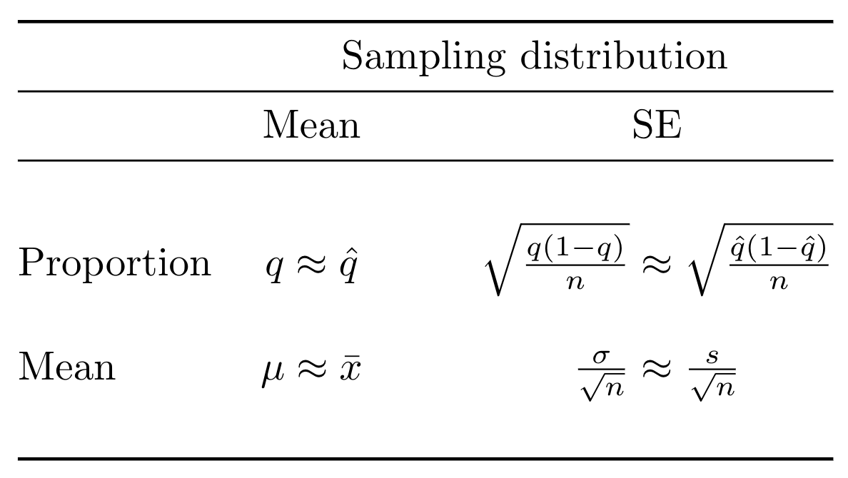
T-distribution for Two Types of Uncertainty...

Slide 13
T-distribution for Two Types of Uncertainty...
If we knew the true population proportion, q, then we would automatically know the mean and SE of the sampling distribution.

Slide 14
T-distribution for Two Types of Uncertainty...
In general, we don’t know q, so we use our sample estimate q-hat to approximate it.

Slide 15
T-distribution for Two Types of Uncertainty...
For means, we use two different quantities: the sample mean approximates the population mean,

Slide 16
T-distribution for Two Types of Uncertainty...
For means, we use two different quantities: the sample mean approximates the population mean, and the sample standard deviation approximates the population standard deviation.

Slide 17
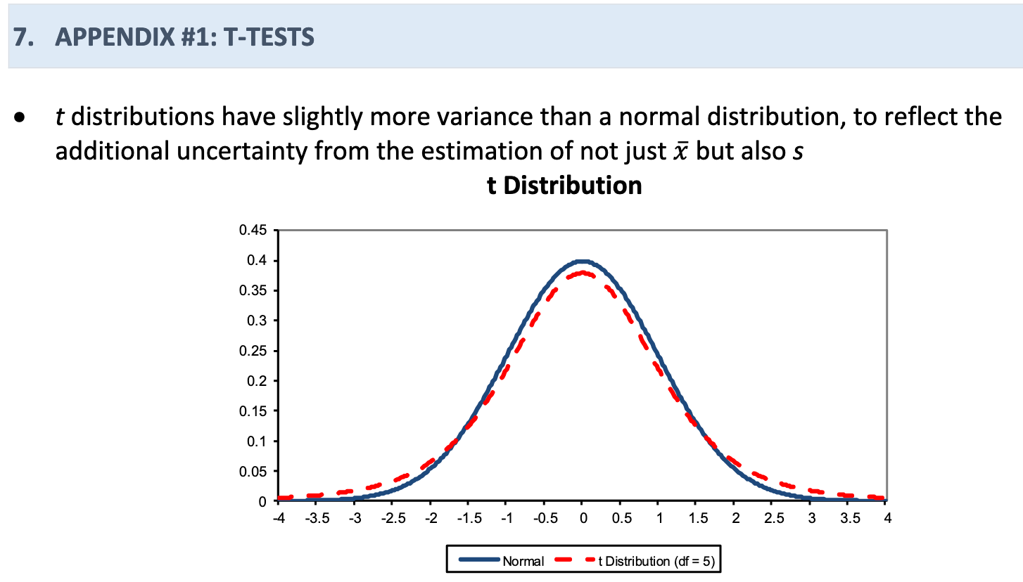
T-distribution for Two Types of Uncertainty...
From Handout 15:

Slide 18
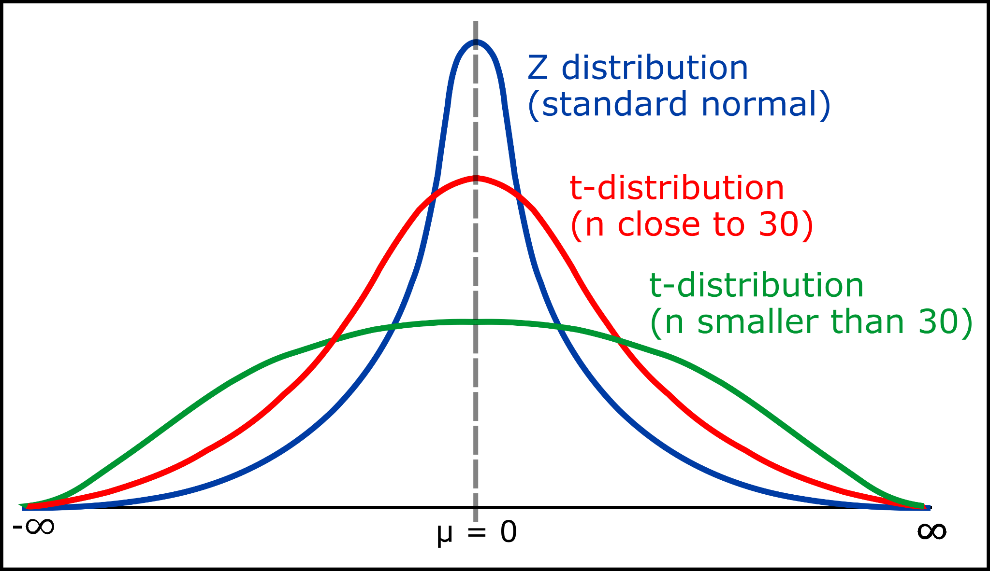
T-distribution vs Normal distribution
Compared to the Normal distribution, the t-distribution has:
-a similar shape (symmetric, unimodal)
-“Fatter tails”, aka higher spread
-an additional parameter: the degrees of freedom.
For a single mean, df = n-1
For a difference in means we use the smaller of the 2 sample sizes,
df = n_{smaller}- 1

Slide 19
T-distribution vs Normal distribution
When n > 30, the t-distribution becomes v close to normal!
Compared to the Normal distribution, the t-distribution has:
-a similar shape (symmetric, unimodal)
-“Fatter tails”, aka higher spread
-an additional parameter: the degrees of freedom.
For a single mean, df = n-1
For a difference in means we use the smaller of the 2 sample sizes,
df = n_{smaller}- 1

Slide 20
Which distribution to use?
Note: 𝝈 = population standard deviation
For proportions / difference-in-proportions:
→ normal distribution
For means / difference-in-means:
If 𝝈 is known → normal distribution
If 𝝈 is unknown → t-distribution

Slide 21
Which distribution to use?
Note: 𝝈 = population standard deviation
For proportions / difference-in-proportions:
→ normal distribution
For means / difference-in-means:
If 𝝈 is known → normal distribution
If 𝝈 is unknown → t-distribution
(though if we have a “large sample”, say n > 30, this is basically equivalent to the normal anyway!)

Slide 22
Practice Problem

Slide 23
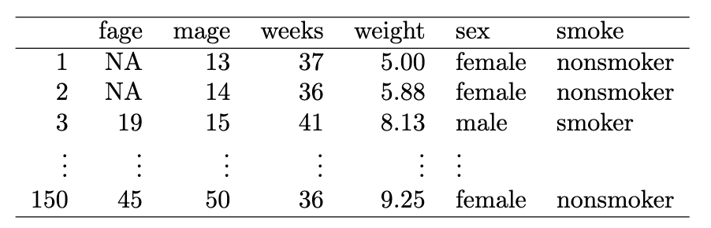
Practice Problem: Baby weights
Do newborns from mothers who smoke have a different average birth weight than newborns from mothers who don’t smoke?
Let’s test this using a dataset from North Carolina including 50 mothers who smoke and 100 mothers who don’t.
From OIS Exercise 7.3.2

Slide 24
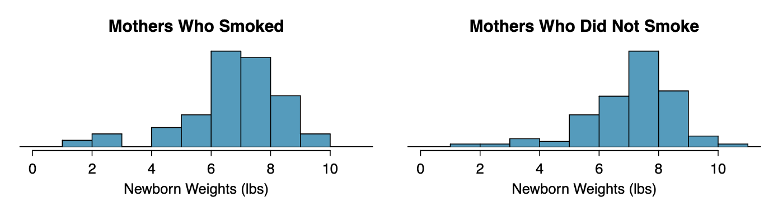
Practice Problem: Baby weights
Do newborns from mothers who smoke have a different average birth weight than newborns from mothers who don’t smoke?
Let’s test this using a dataset from North Carolina including 50 mothers who smoke and 100 mothers who don’t.
From OIS Exercise 7.3.2

Slide 25
Practice Problem: Baby weights
Do newborns from mothers who smoke have a different average birth weight than newborns from mothers who don’t smoke?
Let’s test this using a dataset from North Carolina including 50 mothers who smoke and 100 mothers who don’t.
From OIS Exercise 7.3.2

Slide 26
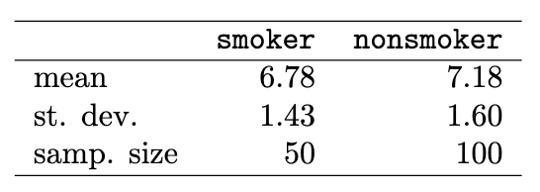
Practice Problem: Baby weights
Do newborns from mothers who smoke have a different average birth weight than newborns from mothers who don’t smoke?
Let’s test this using a dataset from North Carolina including 50 mothers who smoke and 100 mothers who don’t.
What is the null hypothesis?
From OIS Exercise 7.3.2

Slide 27

Practice Problem: Baby weights
Do newborns from mothers who smoke have a different average birth weight than newborns from mothers who don’t smoke?
Let’s test this using a dataset from North Carolina including 50 mothers who smoke and 100 mothers who don’t.
What is the null hypothesis?
H₀: There is no difference in average birth weight for newborns from mothers who did and did not smoke.
In notation:
From OIS Exercise 7.3.2

Slide 28
Practice Problem: Baby weights
Do newborns from mothers who smoke have a different average birth weight than newborns from mothers who don’t smoke?
Let’s test this using a dataset from North Carolina including 50 mothers who smoke and 100 mothers who don’t.
2. What is our estimate of the difference?
From OIS Exercise 7.3.2

Slide 29

Practice Problem: Baby weights
Do newborns from mothers who smoke have a different average birth weight than newborns from mothers who don’t smoke?
Let’s test this using a dataset from North Carolina including 50 mothers who smoke and 100 mothers who don’t.
2. What is our estimate of the difference?
= 7.18 - 6.78 = 0.4
From OIS Exercise 7.3.2

Slide 30
Practice Problem: Baby weights
Do newborns from mothers who smoke have a different average birth weight than newborns from mothers who don’t smoke?
Let’s test this using a dataset from North Carolina including 50 mothers who smoke and 100 mothers who don’t.
3. What is the standard error of this estimate?
From OIS Exercise 7.3.2

Slide 31
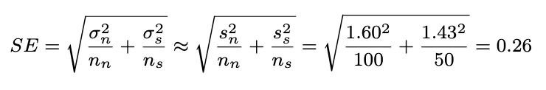
Practice Problem: Baby weights
Do newborns from mothers who smoke have a different average birth weight than newborns from mothers who don’t smoke?
Let’s test this using a dataset from North Carolina including 50 mothers who smoke and 100 mothers who don’t.
3. What is the standard error of this estimate?
From OIS Exercise 7.3.2

Slide 32
Practice Problem: Baby weights
Do newborns from mothers who smoke have a different average birth weight than newborns from mothers who don’t smoke?
Let’s test this using a dataset from North Carolina including 50 mothers who smoke and 100 mothers who don’t.
4. What is the test statistic?
From OIS Exercise 7.3.2

Slide 33
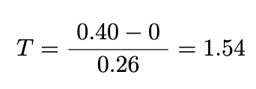
Practice Problem: Baby weights
Do newborns from mothers who smoke have a different average birth weight than newborns from mothers who don’t smoke?
Let’s test this using a dataset from North Carolina including 50 mothers who smoke and 100 mothers who don’t.
4. What is the test statistic?
From OIS Exercise 7.3.2

Slide 34
Practice Problem: Baby weights
Do newborns from mothers who smoke have a different average birth weight than newborns from mothers who don’t smoke?
Let’s test this using a dataset from North Carolina including 50 mothers who smoke and 100 mothers who don’t.
4. What is the p-value corresponding to this test statistic?
First decide what the degrees of freedom should be.
Then use this Excel formula to get the p-value:
=TDIST(abs(T), df , 2)
From OIS Exercise 7.3.2

Slide 35
Practice Problem: Baby weights
Do newborns from mothers who smoke have a different average birth weight than newborns from mothers who don’t smoke?
Let’s test this using a dataset from North Carolina including 50 mothers who smoke and 100 mothers who don’t.
4. What is the p-value corresponding to this test statistic?
df = n_{smaller} - 1 = 50 - 1 = 49
=TDIST(abs(1.54), 49 , 2) = 0.13
From OIS Exercise 7.3.2

Slide 36
Practice Problem: Baby weights
Do newborns from mothers who smoke have a different average birth weight than newborns from mothers who don’t smoke?
Let’s test this using a dataset from North Carolina including 50 mothers who smoke and 100 mothers who don’t.
5. With a significance level of 5%, what is the conclusion of our hypothesis test?
From OIS Exercise 7.3.2

Slide 37
Practice Problem: Baby weights
Do newborns from mothers who smoke have a different average birth weight than newborns from mothers who don’t smoke?
Let’s test this using a dataset from North Carolina including 50 mothers who smoke and 100 mothers who don’t.
5. With a significance level of 5%, what is the conclusion of our hypothesis test?
0.13 > 0.05
Fail to reject the null that there is no difference in average birth weight based on mother’s smoking status.
From OIS Exercise 7.3.2

Slide 38
Tips for PSet 6

Slide 39
Tips for PSet 6
For Q1, you might find it helpful to look at the glossary on Handout 15, Appendix #2
For the second part: one way to “relate” two concepts is to ask “what happens if this one gets bigger/smaller?”
On Q2, remember that the margin of error = multiplier x SE, so for a 95% CI the MoE = 1.95 x SE
For Q3 (3), see the footnote for guidance on how to draw random numbers in Excel. To prevent these from being recalculated when you sort the table, you can highlight the column, Copy, and then click “Paste Special → Values only”.

Slide 40
Tips for PSet 6
For Q1, you might find it helpful to look at the glossary on Handout 15, Appendix #2
For the second part: one way to “relate” two concepts is to ask “what happens if this one gets bigger/smaller?”
On Q2, remember that the margin of error = multiplier x SE, so for a 95% CI the MoE = 1.95 x SE
For Q3 (3), see the footnote for guidance on how to draw random numbers in Excel. To prevent these from being recalculated when you sort the table, you can highlight the column, Copy, and then click “Paste Special → Values only”.

Slide 41
Tips for PSet 6
For Q1, you might find it helpful to look at the glossary on Handout 15, Appendix #2
For the second part: one way to “relate” two concepts is to ask “what happens if this one gets bigger/smaller?”
On Q2, remember that the margin of error = multiplier x SE, so for a 95% CI the MoE = 1.95 x SE
For Q3 (3), see the footnote for guidance on how to draw random numbers in Excel. To prevent these from being recalculated when you sort the table, you can highlight the column, Copy, and then click “Paste Special → Values only”.

Slide 42
Tips for PSet 6
For Q1, you might find it helpful to look at the glossary on Handout 15, Appendix #2
For the second part: one way to “relate” two concepts is to ask “what happens if this one gets bigger/smaller?”
On Q2, remember that the margin of error = multiplier x SE, so for a 95% CI the MoE = 1.95 x SE
For Q3 (3), see the footnote for guidance on how to draw random numbers in Excel. To prevent these from being recalculated when you sort the table, you can highlight the column, Copy, and then click “Paste Special → Values only”.

